Slide 1
Facil notes
Make sure all three jumpers are on the L298N
SAFETY IS A HUGE CONCERN please make sure the analog input is less than 100 because otherwise it do be fast
Make sure they test the motors first
You can use a breadboard+batterypack+4x batteries to test a motor
When running thru this set of slides, run it with the animations first cus the video got a certain starting point at 7min+
Some computers might require other drivers to sense the Arduino. Please help download either FTDI or the CH3something one.

Slide 2
Prerequisites
Arduino IDE
https://www.Arduino.cc/en/software
Adafruit Motor Controller Library
https://learn.adafruit.com/adafruit-motor-shield/library-install OR
Arduino IDE -> tools -> Manage Libraries -> Search for ‘Adafruit motor’ -> Download the first one, version 1.0.1
Check if your computer can identify the Arduino board. Else, ask a facilitator to troubleshoot.
Download source code from Github
https://github.com/hithfaernith/soarltws.git
(Soarry, no ssh!)
Some computers might require other drivers to sense the Arduino.

Slide 3
Line Tracing Workshop
Sem 1 Week 9
SUTD ORGANIZATION OF AUTONOMOUS ROBOTICS

Slide 4
Prerequisites
Arduino IDE
https://www.Arduino.cc/en/software
Adafruit Motor Controller Library
https://learn.adafruit.com/adafruit-motor-shield/library-install OR
Arduino IDE -> tools -> Manage Libraries -> Search for ‘Adafruit motor’ -> Download the first one, version 1.0.1
Check if your computer can identify the Arduino board. Else, ask a facilitator to troubleshoot.
Download source code from Github
https://github.com/hithfaernith/soarltws.git
(Soarry, no ssh!)
Some computers might require other drivers to sense the Arduino.

Slide 5
SAFETY
Please observe social distancing measures
Else our W9 workshop can’t continue ☹
DON’T ADD BATTERIES UNTIL FACILITATORS APPROVE OF WIRING
Please don’t short the batteries
Don’t touch the exposed wiring/solder points
In analogWrite, don’t give the motor a power input of more than 100.
Don’t upload code that activates motors until a facil has seen it.

Slide 6
Agenda
Arduino IDE (0.33h, 2sf)
Hardware (1800s)
Line Tracing Logic (1/2h)
PID Theory (15 mins)

Slide 7
Progress
Arduino IDE
Hardware
Line Tracing Logic
PID Theory

Slide 8
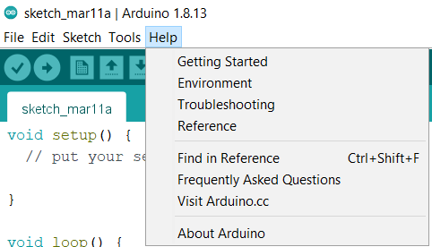
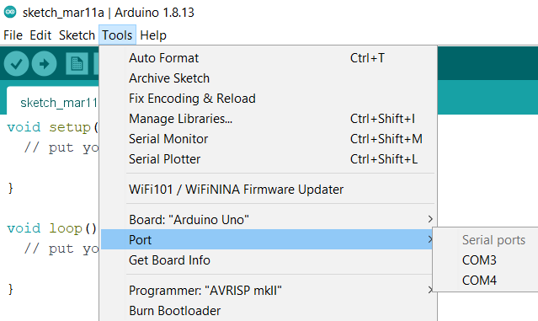
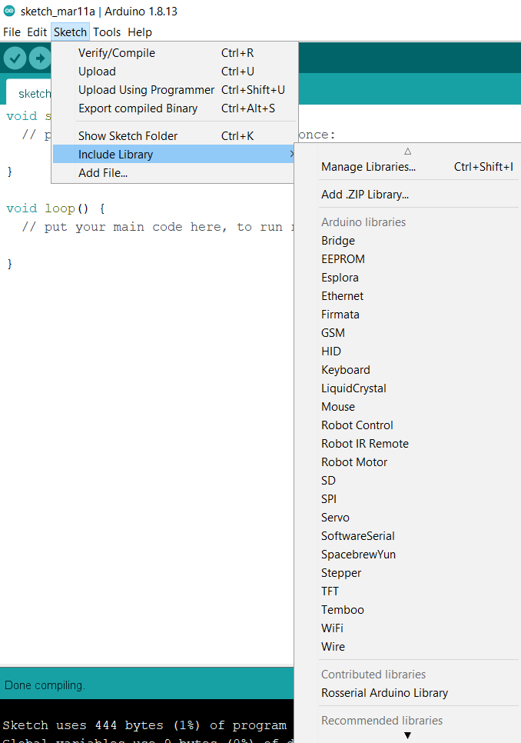
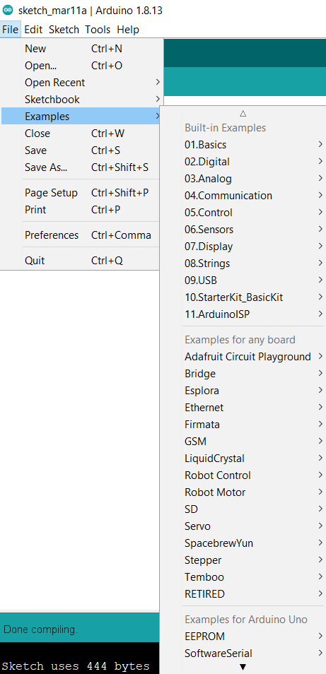
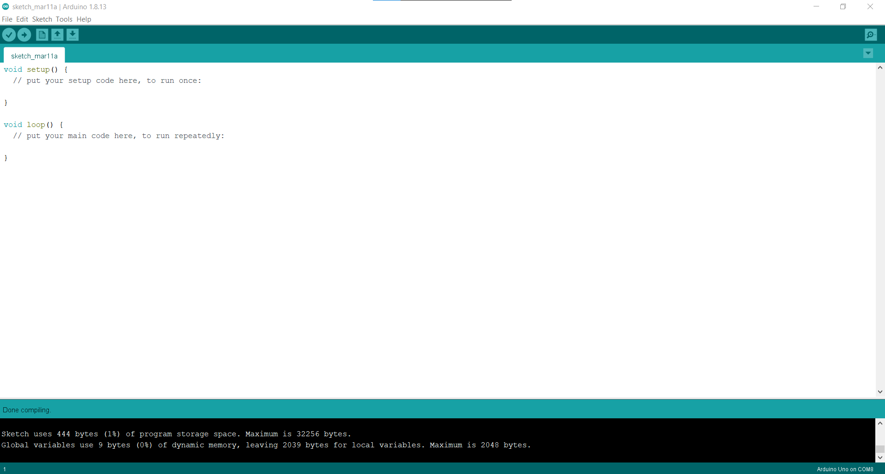
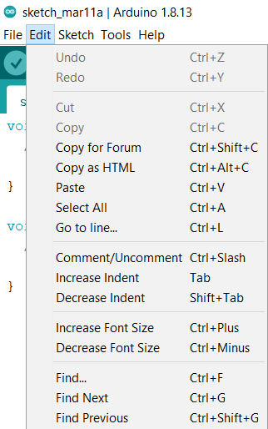
Arduino IDE
Notes:
This slide has animations, go present to see whats going on! Introduce each thing iff everyone new

Slide 9
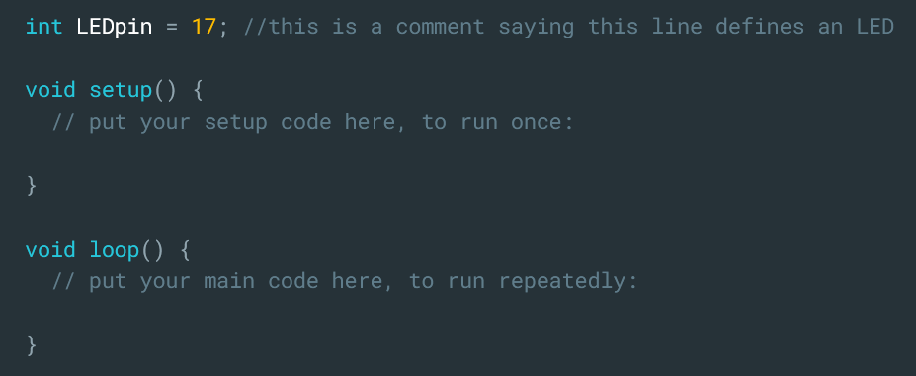
//int;

Slide 10
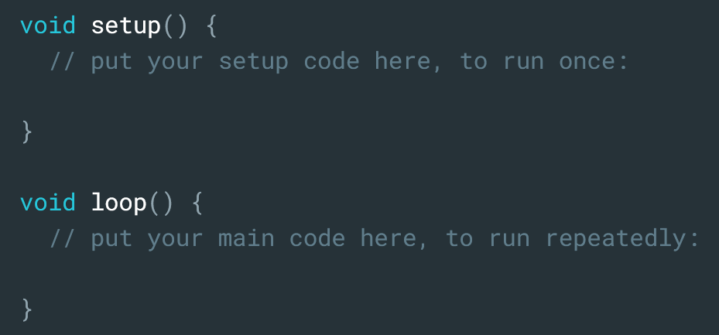
setup(), loop()

Slide 11
setup()

Slide 12
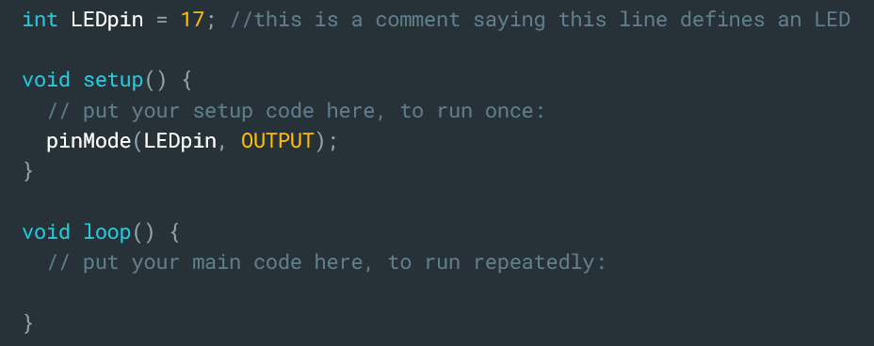
pinMode(pin, type);

Slide 13
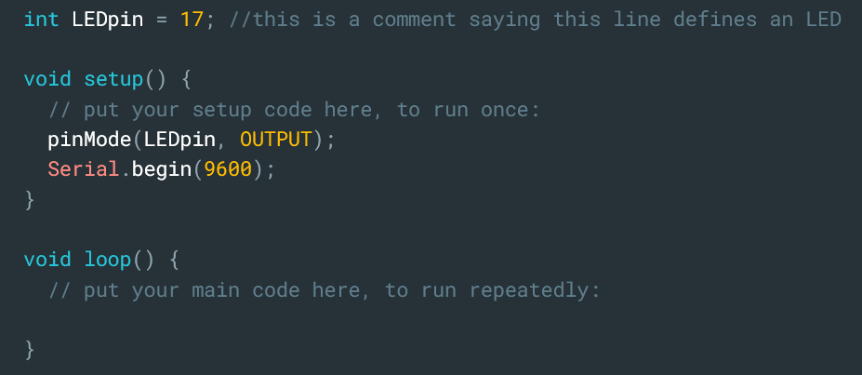
Serial.begin(frequency);

Slide 14
loop()

Slide 15
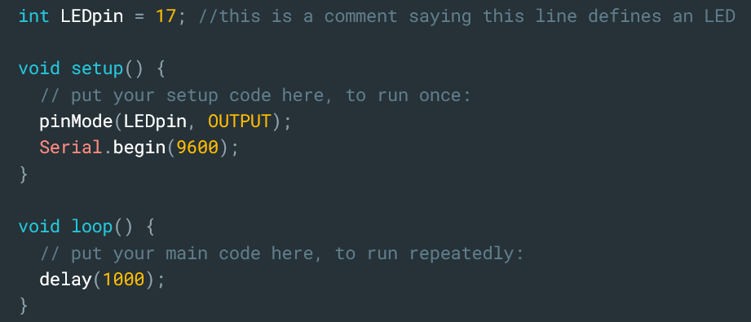
delay()

Slide 16
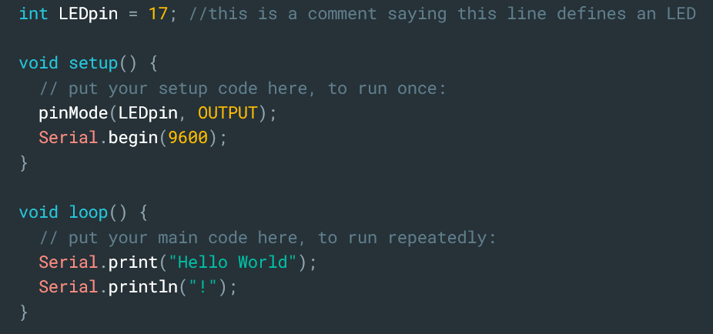
Serial.print()

Slide 17
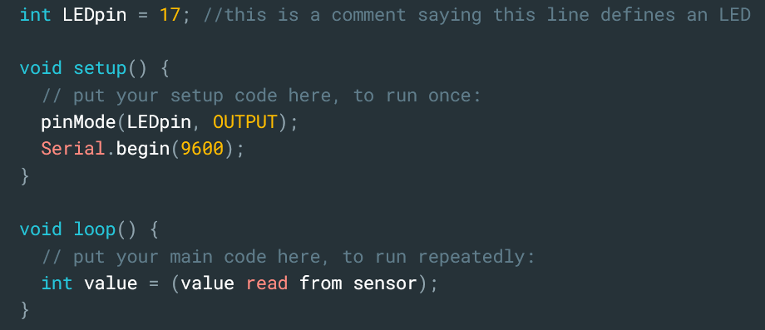
more inting

Slide 18
Print the value from a sensor!
Do this on paper first – write out the logic, determine what the variables are named, then choose a way to display the value

Slide 19
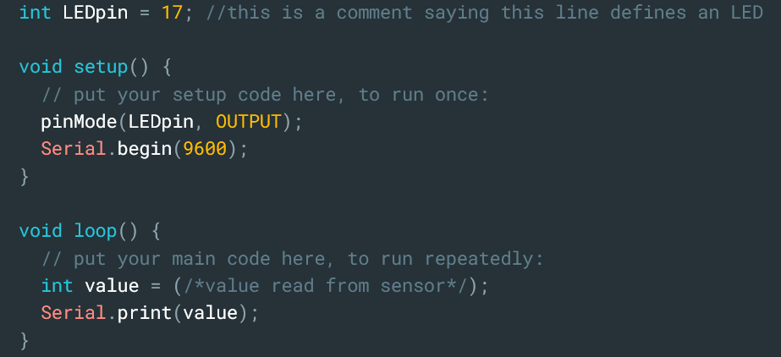
Print the value from a sensor

Slide 20
Print the value from a sensor
Pin interactions
Digital
Analog
analogWrite(Apin, state)
analogRead(Apin)
digitalWrite(pin, state)
digitalRead(pin)

Slide 21
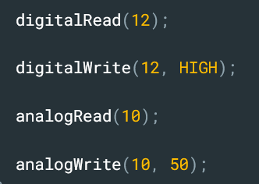
Print the value from a sensor
Pin interactions
Digital
Analog
analogWrite(Apin, state)
analogRead(Apin)
digitalWrite(pin, state)
digitalRead(pin)

Slide 22
Progress
Arduino IDE
Hardware
Line Tracing Logic
PID Theory

Slide 23
Workflow
Decide variables
Choose electronics
First draft of code (well commented!)
Trial and error

Slide 24
Workflow
Decide variables
Choose electronics
First draft of code (well commented!)
Trial and error

Slide 25
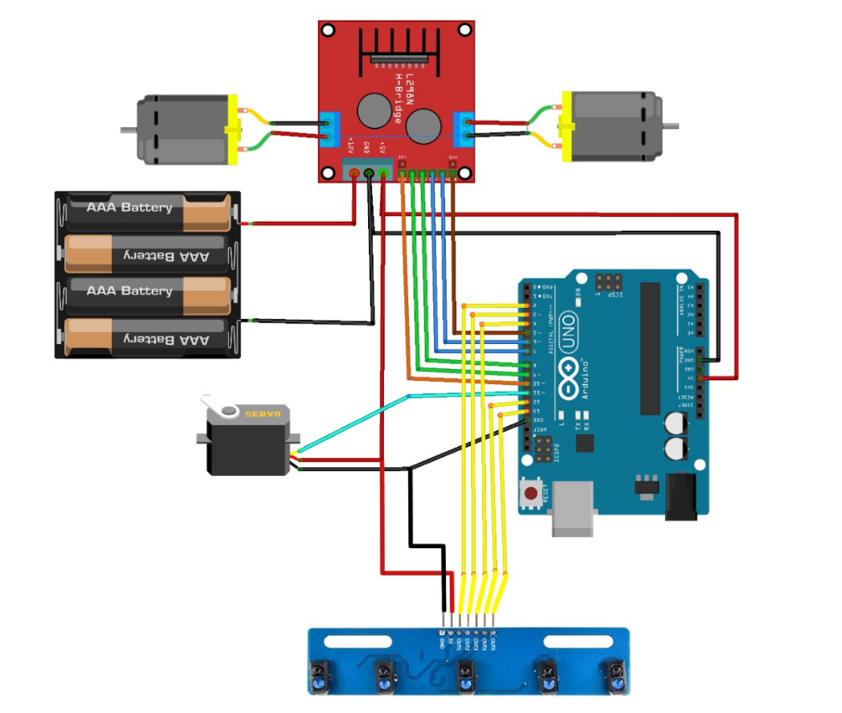
Notes:
Credits to SOAR seniors’ line tracing workshop slides for BUILDSomething

Slide 26
Notes
I/O = Input/Output
analogRead is used for PWM (pulse width modulation)
PWM pins: 5, 6, 9 and 10 on UNO
Battery pack ground and Arduino ground must be the same
Put both in L298N Ground pin.

Slide 27
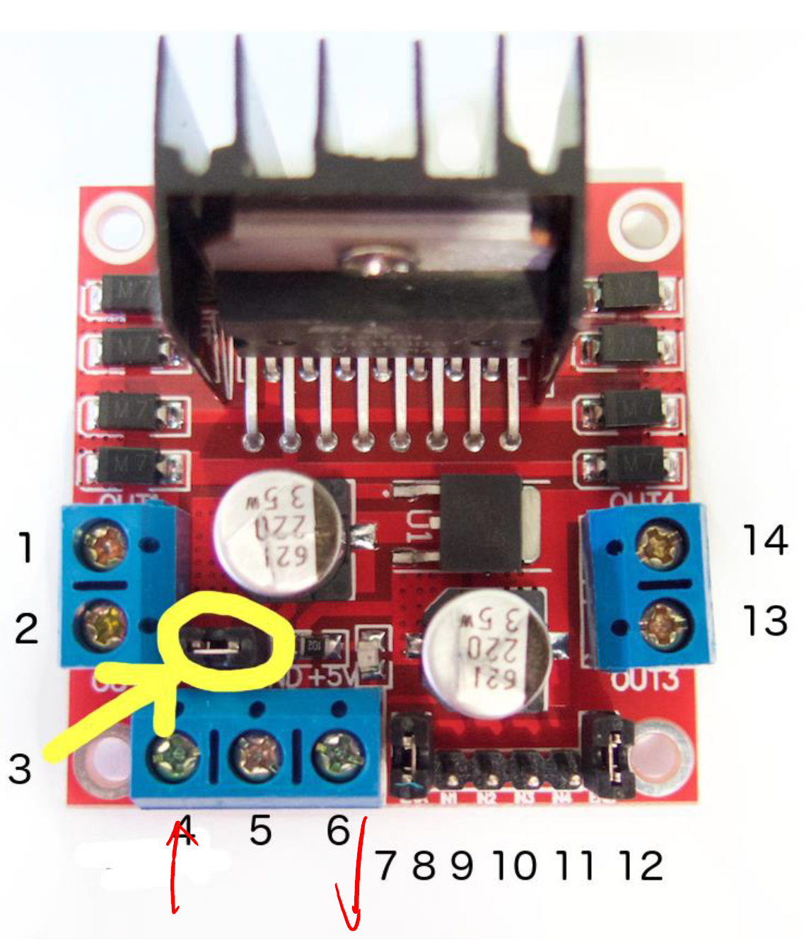
DC motor 1 "+"
DC motor 1 "
12V jumper
Only remove this if using a supply voltage greater than 12V DC.
This enables power to the onboard 5V regulator
Motor supply voltage
Maximum of 35V DC
Remove 12V jumper if > 12V DC
GND
5V output if 12V jumper in place
Can be input as well

Slide 28
DC motor 1 enable jumper
Usually connected to PWM output for speed control
Do not remove the jumper (yet)
IN1 (digital input pin) (controls motor 1)
IN2 (digital input pin) (controls motor 1)
IN3 (digital input pin) (controls motor 2)
IN4 (digital input pin) (controls motor 2)
DC motor 2 enable jumper
DC motor 2 "+"
DC motor 2 " "--"

Slide 29
USB connected, switch off
Arduino 5V
COM 5V
L298N
IR sensor array
Other components

Slide 30
USB disconnected, switch on
L298N
Battery Pack
IR sensor array
Arduino

Slide 31
SAFETY
Please observe social distancing measures
Else our W9 workshop can’t continue ☹
DON’T ADD BATTERIES UNTIL FACILITATORS APPROVE OF WIRING
Don’t short the batteries
Don’t touch the exposed wiring/solder points
In analogWrite, don’t give the motor a power input of more than 100.

Slide 32
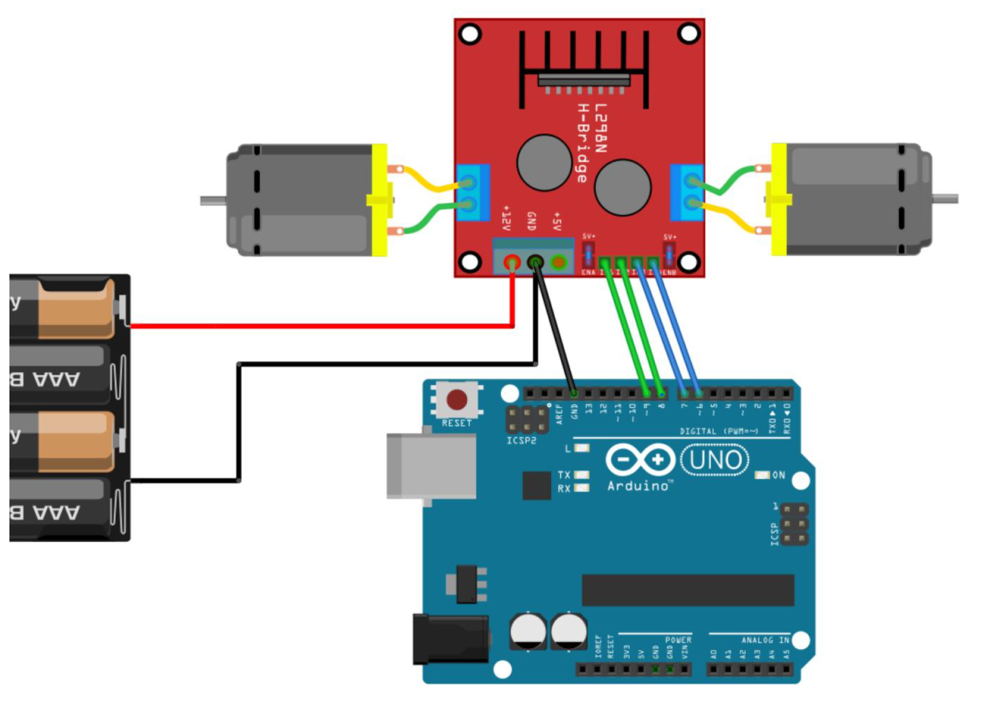
Wiring
Connect Motor 1 and Motor 2 as shown.
The lead doesn’t matter, only direction of motion is affected which can be altered in code
Connect power supply + ve to +12V and -ve to GND
Connect pin in1 to pin 9 on Arduino
Connect pin in2 to pin 8 on Arduino
Connect pin in3 to pin 5 on Arduino
Connect pin in4 to pin 6 on Arduino
Connect GND to GND on Arduino
Both chips must be on a common ground.
Note: Schematics show steps 3-6 connected to different pins than stated.

Slide 33
Wiring
Connect 5V from IR sensor to 5V on Arduino
Connect Gnd from IR sensor to another Gnd from Arduino
Connect OUT2 from IR sensor to any free Arduino pin
Connect OUT4 from IR sensor to any free Arduino pin

Slide 34
Task 1
Make each motor turn in a specific direction for 1s.
This code will be used as a trial for your wiring.
HINT: 1s = 1000ms
-ALTERNATIVE-
Make the robot turn by sending different power to each motor.
HINT: use analogWrite()
Task 2
Record down all used Arduino pin numbers and their connections.

Slide 35
Task 1
Make each motor turn in a specific direction for 1s.
This code will be used as a trial for your wiring.
HINT: 1s = 1000ms
-ALTERNATIVE-
Make the robot turn by sending different power to each motor.
HINT: use analogWrite()
Task 2
Record down all used Arduino pin numbers and their connections.
Found from Github as motor1103ltws.ino
Sample:
Motor 1 IN1: 5
Motor 1 IN2: 6
Motor 2 IN3: 9
Motor 2 IN4: 10
IR OUT2: 2
IR OUT3: 3

Slide 36
Write out the pseudocode for a line tracer!
Do this on paper first – write out the logic, determine where the electronics are connected, and do some tests to find certain threshold values.

Slide 37
</br>

Slide 38
Workflow
Decide variables
Choose electronics
First draft of code (well commented!)
Trial and error

Slide 39
Progress
Arduino IDE
Hardware
Line Tracing Logic
PID Theory

Slide 40
Logic (1)
Both IR sensors sense white -> continue straight
Notes:
Credits to the SOAR seniors’ basic Arduino slides :’)

Slide 41
Logic (2)
Right sensor senses black -> Turn right
Notes:
Credits to the SOAR seniors’ basic Arduino slides :’)

Slide 42
Logic (3)
Left sensor senses black -> Turn left
Notes:
Credits to the SOAR seniors’ basic Arduino slides :’)

Slide 43
Logic(4)
Both senses black -> STOP
Notes:
Credits to the SOAR seniors’ basic Arduino slides :’)

Slide 44
Conditionals
Condition | Reaction
Both sense white | Move forward
Left senses black | Turn left
Right senses black | Turn right
Both sense black | Stop
Notes:
Credits to the SOAR seniors’ basic Arduino slides :’)

Slide 45
Conditionals
> | GREATER THAN | (5 > 4) IS TRUE
< | LESS THAN | (4 < 5) IS TRUE
>= | GREATER THAN OR EQUAL TO | (4 >= 4) IS TRUE
<= | LESS THAN OR EQUAL TO | (3 <= 4) IS TRUE
== | EQUAL TO | (5 == 5) IS TRUE
!= | NOT EQUAL TO | (5 != 4 ) IS TRUE
Notes:
Credits to the SOAR seniors’ basic Arduino slides :’)

Slide 46
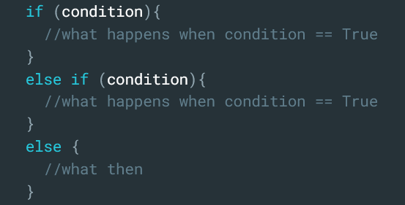
Others
&& | and | (a && b)==True if a==True and b==True
|| | or | (a || b)==True if a==True or b==True
if/else works like this:
Notes:
Credits to the SOAR seniors’ basic Arduino slides :’)

Slide 47
Workflow
Decide variables
Choose electronics
First draft of code (well commented!)
Trial and error

Slide 48
Missions
MISSION 1
MISSION 11
MISSION 111
Launch the robot at the marked box and end at the line. Complete at least one route.
Launch the robot at the marked box, make a U-turn at the line and stop at base.
Use all 5 sensors in the line tracing algorithm.

Slide 49
Progress
Arduino IDE
Hardware
Line Tracing Logic
PID Theory

Slide 50

PD/PID explanation

Slide 51
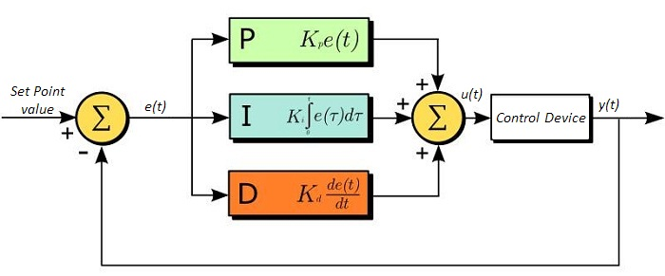
PID flow

Slide 52

PID notes
“The output of the PID control circuit, u(t), is given as
$$u\left(t\right)=MV\left(t\right)=K_{p}e\left(t\right)+ K_{i}\int_{0}^{t}{e\left(τ\right)dτ}+K_{d}\frac{d}{dt}e(t)$$
where
Kp= Proportional Gain
Ki = Integral Gain
Kd = Derivative Gain
e(t) = SP - PV(t)”

Slide 53

(Anon) Feedback Form
Line Tracing Workshop
Sem 1 Week 9

Slide 54
TITLE two
Pointer 1

Slide 55
TITLE three
Pointer 1
Pointer 2
BODY TEXT

Slide 56
Pointer 1
Pointer 2
Pointer 1
Pointer 2

Slide 57
TITLE four
BODY TEXT
BODY TEXT
BODY TEXT
Pointer 1
Pointer 2
Pointer 1
Pointer 2
Pointer 1
Pointer 2

Slide 58
TITLE five
Pointer 1
Pointer 2
Pointer 1
Pointer 2
Pointer 1
Pointer 2
BODY TEXT

Slide 59
TITLE five
BODY TEXT
BODY TEXT
BODY TEXT
BODY TEXT

Slide 60











































